Slide 1
Red Shift

Slide 2
By the end of this lesson, you should be able to:
Describe red shift.
Explain the causes of red shift.
Discuss how red shift acts as evidence for the Big Bang Theory.

Slide 3
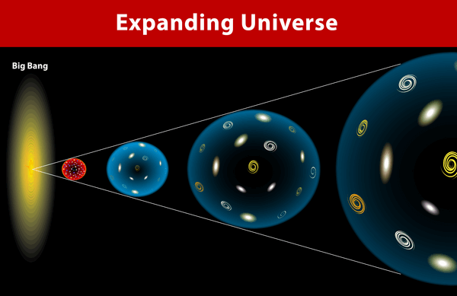
One prediction of the Big Bang Theory is that the universe is expanding outwards, and has been since the Big Bang.
Therefore, evidence of a continually-expanding universe would provide support for the theory.

Slide 4
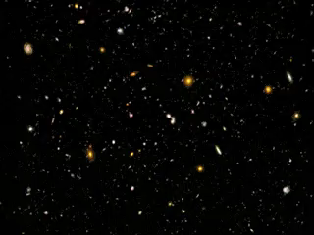
Every star and galaxy in the universe is moving.
All of this movement is caused by a mixture of the expansion of the universe and gravity.

Slide 5
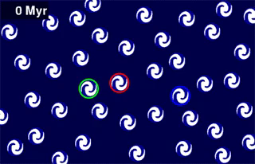
When the universe is said to be expanding, this doesn't just mean that the edges are getting larger.
Rather, every part of the universe is expanding at once.
Every point of space is constantly being pulled away from every other point of space, at the same time, all of the time.

Slide 6
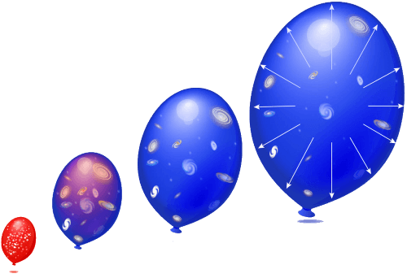
You can do an experiment to visualise this idea.
Take an uninflated balloon and use a marker to cover it with dots, and then blow it up. See how the dots get further and further apart without moving?
The space between each dot is expanding in two dimensions. The same thing is happening to the universe. All three dimensions of space are expanding and this is slowly pulling everything apart.

Slide 7

The expansion of the universe is resisted by gravity.
Gravity is a force that pulls masses together.
Gravity directly opposes the expansion of the universe. This is what keeps us, the Earth, the Solar System and the Milky Way from being separated.

Slide 8
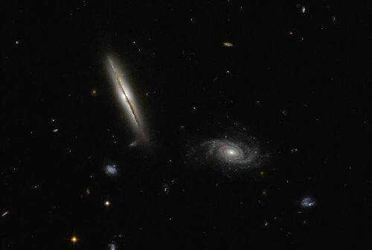
When we observe the universe, we see the distant stars and galaxies moving away from Earth.
Closer to home, we find that the movement of objects is mostly caused by gravity, rather than universal expansion. So any direction of movement is possible.

Slide 9
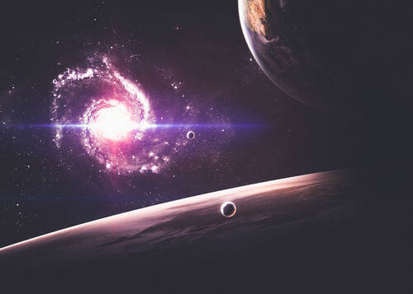
There is an area of space called the Local Group.
This area contains the Milky Way, the Andromeda galaxy, the Triangulum galaxy and a large amount of other stellar groups.
It's about 10 Mly (mega-light years) across, and within this space we can observe that stars and galaxies are moving in many different directions.
Beyond this space, however, we can observe that almost every other galaxy is moving away from the Milky Way.

Slide 10

The stars release a continuous spectrum of light.
The strongest frequency in the spectrum determines the colour, but stars emit light of every colour.
But an interesting pattern emerges when you study the spectrum of a star. Some frequencies are not actually emitted, and show up as black lines on the spectrum.

Slide 11
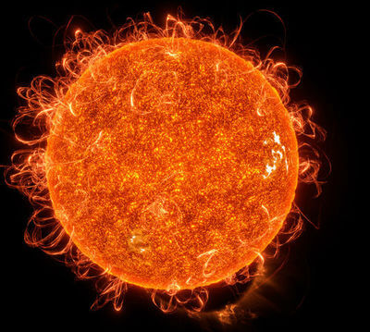
The lines on the spectrum are the absorption spectrum of the star.
They correspond to colours (wavelengths) of light which are absorbed by the elements in the star.
Different elements absorb different wavelengths of light. By studying the missing wavelengths of a spectrum, we can figure out which elements a star contains.

Slide 12

However, in many cases the absorption spectrum is shifted from the expected positions.
If the spectrum is shifted towards the lower frequencies, the spectrum becomes more red. We call this a redshift.
If the spectrum is shifted towards the higher frequencies, the spectrum becomes more blue. We call this a blueshift (pictured below).

Slide 13

Red shifts are caused by the expansion of space.
A light wave that is moving from a red shifted star towards Earth will be moving through expanding space, and this causes the light wave itself to expand.
Increasing the wavelength of the light moves the colour towards red, so the light appears to be shifted towards red.

Slide 14

Blue shifts are caused by stars moving towards Earth.
A light wave that is moving from a blue shifted star towards Earth has a compressed wavelength because of the Doppler effect.
For more on the Doppler effect, see this link.
For the Doppler effect to apply, gravity must be pulling the star towards Earth faster than the space between is expanding.
Decreasing the wavelength of the light moves the colour towards blue, so the light appears to be shifted towards blue.

Slide 15
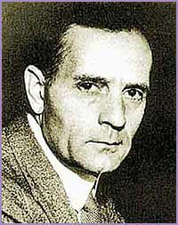
Edwin Hubble was an astronomer who provided evidence that other galaxies exist beyond the Milky Way.
While studying other galaxies, he carefully inspected their light spectra. What Hubble found was that almost every galaxy gives off redshifted light.
Only some close galaxies, like Andromeda, displayed a blue shift.

Slide 16

What Hubble concluded was that almost every other galaxy in the universe is moving away from Earth.
But not only that! Hubble also observed that the red shift on the furthest galaxies is actually larger than the redshift on closer ones.
Red shift increases as the speed of a star increases. So what Hubble found was that the further away a galaxy is, the faster it is moving away from us.

Slide 17
Hubble's two observations suggest that the universe is expanding, because the galaxies need somewhere to move into.
This theory acts as effective evidence for the Big Bang. If the universe is expanding, it implies that at some point it was a lot smaller and had to begin expanding.

Slide 18
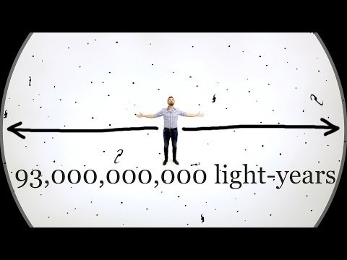

Slide 19
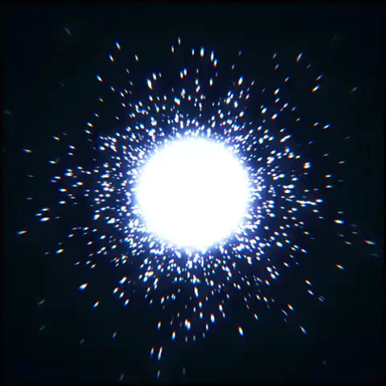
It is important to note that galaxies may appear to move faster than the speed of light when their redshift is examined.
This is because the space between galaxies is able to expand faster than light.
The speed of light limit only applies to matter and energy, not the space that the matter is in.

